Slide 1
March 18th, 2019
Sustainable Industry: Rinse Over Run Modeling Report
Arindam Bhattacharya

Slide 2

Executive Summary
Executive Summary | Feature Engineering | Modeling | Performance | Insights | Conclusion
End-to-end overview of analytical process
Problem Statement
Goal: increased resource efficiency when cleaning food and beverage industrial equipment while maintaining high cleaning standards Solution approach: build model that accurately predicts the total residue* during the final rinse phase using historical cleaning data Produce empirical, model-derived insights into the factors that drive increased turbidity during the final rinse phase
Data Preparation and Feature Engineering
Extensive feature engineering to distill time-series data into a set of representative characteristics during supply and return phases Features primarily generated at a phase-level of granularity or lower, allowing for straightforward simulation of mid-process predictions Data cleaning included outlier detection and minor data imputation
Modeling
Four separate models, one corresponding to the end of each phase LightGBM boosted tree model with custom loss function Training/validation splits created using walk-forward/rolling origin techniques; training data ranges from first 44 to 56 days of available data Estimates of generalization error obtained through weighted average of validation set errors across all four models
Performance and Insights
Best average MAPE on holdout test data (private leaderboard): 27.4% Model-driven insights derived using SHAP (Shapley Additive Explanations) Primary factor that influences total final phase residue: the specific type of object being cleaned, or object_id Additional key factors: total weighted turbidity and residue, minimum temperature, minimum conductivity, recipe type
1
*Residue is our simplified nomenclature for the response variable during modeling, “total_turbidity_liter” (total quantity of turbidity * outgoing flow).

Slide 3
Feature Engineering
Executive Summary | Feature Engineering | Modeling | Performance | Insights | Conclusion
Phase subdivision, time-series aggregations
Return valve states during a typical cleaning process
Phase | Return Phase
Pre-rinse | Pre-Rinse-Drain
Caustic | Caustic-Caustic
Int. Rinse | Int-Rinse-Caustic
Int. Rinse | Int-Rinse- Recovery-Water
Acid | Acid-Recovery- Water
Acid | Acid-Acid
Return Valve
Drain Caustic
Recovery Water Acid
Pre-rinse
Caustic
Int. Rinse
Acid
Phase
The above diagram illustrates the danger of creating aggregated features at the phase level, as multiple cleaning agents can be
“returned” or “supplied” during a particular phase (pink and red bars).
Consequently, a key initial step was to sub-divide phases into “return phases” and “supply phases” to account for the actual cleaning agent being returned during the phase.
Return-phase and supply-phase combinations that occurred relatively infrequently were bucketed as “other” to reduce overfitting.
Return phase-level features
Supply phase-level features
Phase-level features
Other features
Total residue
Total weighted turbidity*
Minimum conductivity
Duration
Total supply flow of cleaning agent
Minimum supply pressure
Duration
Total residue during end of phase
Total weighted turbidity* during end of phase
Minimum return temperature
Proportion of phase duration during which caustic tank was empty
Proportion of phase duration during which liquid was present in the cleaning object
Object ID
Recipe Type
*Weighted by normalized return flow; details/rationale are presented in Insights section

Slide 4

Modeling
Executive Summary | Feature Engineering | Modeling | Performance | Insights | Conclusion
Modeling and validation techniques
Primary Modeling Technique:
Gradient Boosted Trees (LightGBM)
A state-of-the-art implementation of gradient-boosted decision
trees with several attractive features:
Methodology details
Loss function: 𝐿 𝑦ො, 𝑦 =
𝑦ො_{𝑖} − 𝑦_{𝑖}
max( 𝑦_{𝑖} ,290000)
Directly minimize performance metric
LightGBM typically uses both gradient and Hessian to build trees
Gradient = ^{sgn(𝑦ො𝑖 − 𝑦𝑖)} , Hessian = 0 (where defined)
max( 𝑦_{𝑖} ,290000)
Implemented by modifying source code for LightGBM’s built-in MAPE loss
function, which only uses the gradient to build trees
(custom loss function functionality in Python utilizes a second-order
approximation and requires a non-zero Hessian)
Excellent predictive power
Efficient implementation → short training time (5-10 seconds per model, depending on number of features) → ability to rapidly iterate when developing new features, tuning hyperparameters, etc.
Supports custom loss functions and evaluation metrics
Robust and efficient handling of categorical data – finds optimal splits without the need for alternate encodings (e.g. one-hot)
SHAP (model interpretation technique, discussed later in Insights section) implements a special high-speed, exact algorithm in C++ for LightGBM models that reduces the time required to interpret model output
Walk-forward/rolling origin validation sets
K-fold CV not appropriate for time-series due to data leakage
Training sets ranged from 44 to 56 days of data (64 days of data in total)
Four validation sets per model; average estimated error across all four validation sets to obtain estimated generalization (test set) error
Validation Model 1
Validation Model 2
Validation Model 3
Validation Model 4
Oldest cleaning: Feb. 21st, 2018
Most recent cleaning: April. 25th, 2018

Slide 5
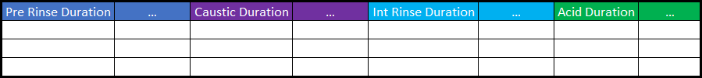
Modeling
Executive Summary | Feature Engineering | Modeling | Performance | Insights | Conclusion
Multiple model rationale and additional methodology details
Additional methodology details
Simulating Mid-Process Predictions with
Multiple Models
Although a single LightGBM model could make predictions at any point in the cleaning process, its performance would be greatly hampered by the considerable missing data in the later stages (e.g. 70% of the acid-phase features). To maximize predictive performance, we built four separate models corresponding to the four phases, simulating a mid-process prediction by excluding the appropriate predictors:
Data cleaning and preparation
Set all negative return and supply flows to zero
Compute object_id-level median statistics for several features, for use during feature normalization (rationale explained in Insights)
Identify and remove outlier records along total process duration (e.g less than 20 seconds total) and response value (e.g. total final rinse residue < 1000) dimensions using quantile-based thresholds
Intentionally avoided techniques
Some commonly used modeling techniques were unsuitable for this analysis, given the importance of model reproducibility and interpretability
Stacking/ensembling: very difficult to determine contributions of variables
to final output when multiple models are combined
PCA, autoencoders, etc.: dimensionality reduction techniques which result in new, significantly less interpretable predictors
Model tuning techniques that involve randomness into the model-building process, such as selecting a random subset of features before building each tree (LightGBM parameter “feature_fraction”); can lead to inconsistent model interpretation across multiple runs
Pre Rinse
Model
Caustic Model
Int. Rinse
Model
Acid (Full)
Model
End of pre-rinse stage predictions
End of caustic stage predictions
End of int. rinse stage predictions
End of acid
stage predictions
Additional benefits of this approach include:
Distinct estimates of generalization error for each type of prediction
Full utilization of the entire training set for all four estimates of test set error
Visibility into the unique factors driving each type of prediction

Slide 6
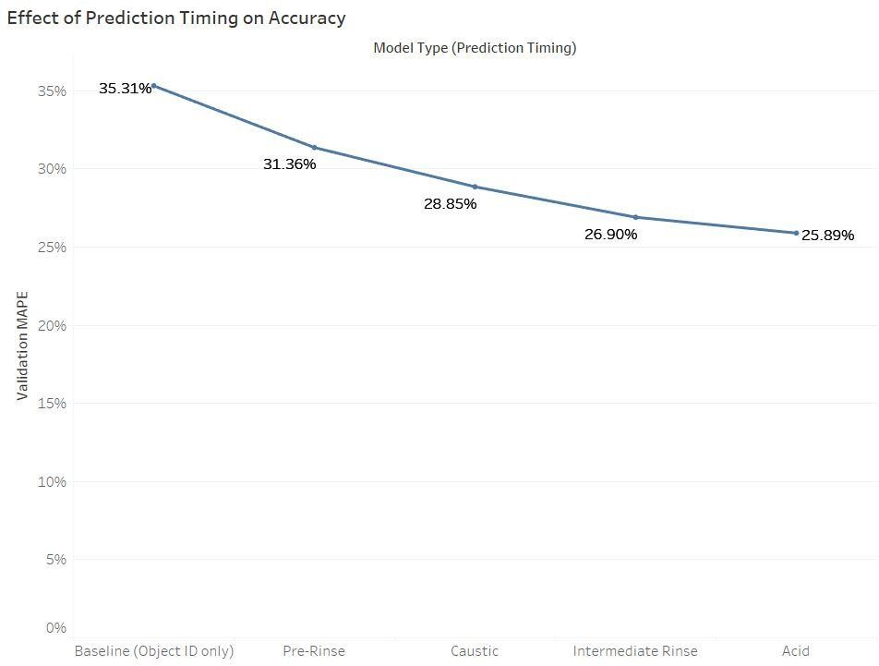
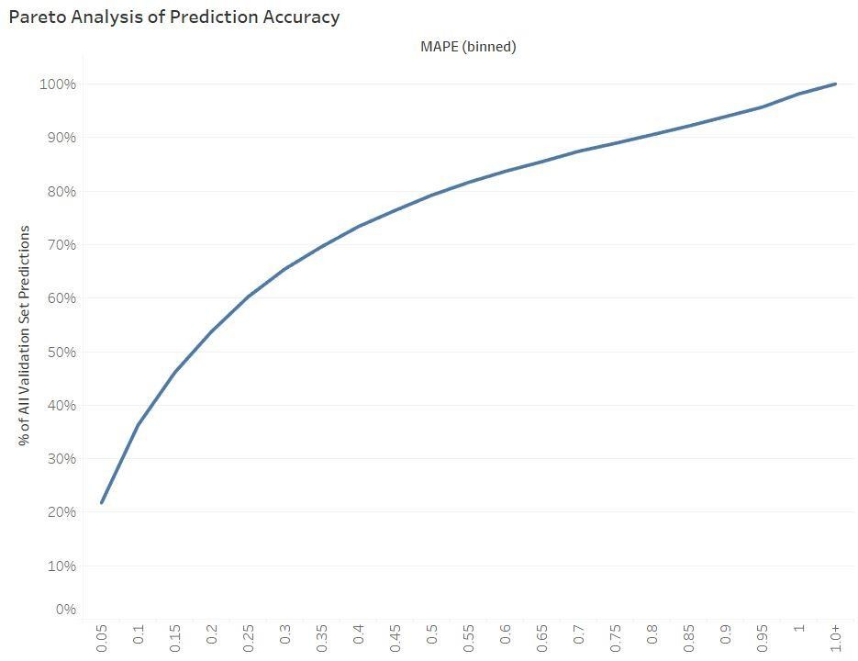
Performance
Executive Summary | Feature Engineering | Modeling | Performance | Insights | Conclusion
Prediction accuracy
Best test set MAPE (private leaderboard): 27.4%
Since we do not have the actual response values from the test set, we can use the predictions made on the validation sets as a proxy for the purposes of evaluating model prediction quality
Effect of Prediction Timing Pareto Analysis
As expected, the later in the cleaning process the prediction is made, the more accurate the model prediction will be
Approximately 20% of validation set predictions were within 5% of the observed response The majority of validation set predictions were within 20% of the observed response Approximately 80% of validation set predictions were within 50% of the observed response

Slide 7
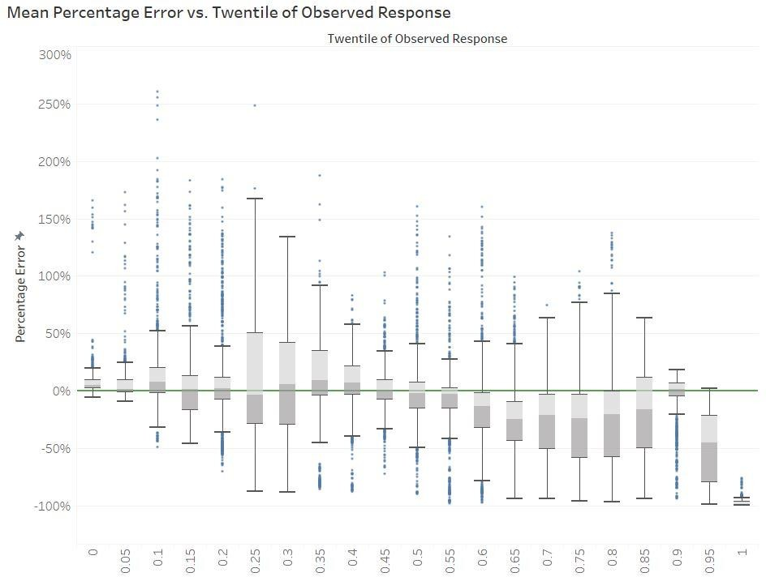
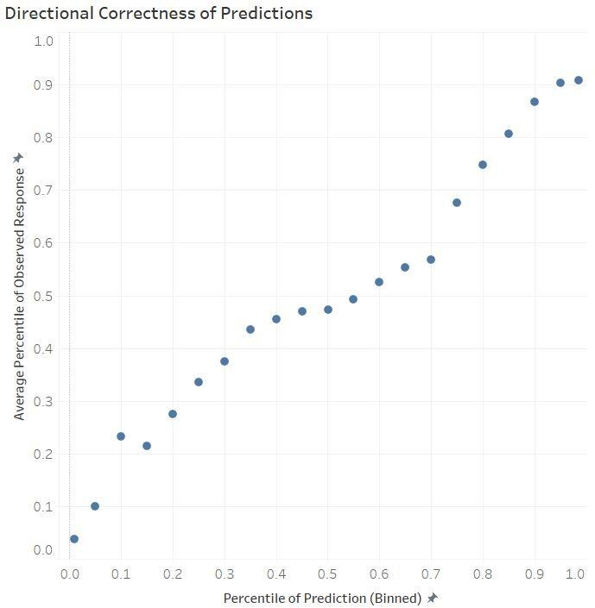

Performance
Executive Summary | Feature Engineering | Modeling | Performance | Insights | Conclusion
Prediction characteristics and patterns
Best test set MAPE (private leaderboard): 27.4%
Since we do not have the actual response values from the test set, we can use the predictions made on the validation sets as a proxy for the purposes of evaluating model prediction quality
Prediction Biases Directional Correctness
Ideally, the boxes would all be centered and symmetric about this reference line at 0%
The model slightly over-predicts the smallest observed values due to the “max(290000,…)” adjustment made to MAPE
The model significantly under-predicts the largest
observed values
This is typical of models that minimize MAPE, due to the asymmetric costs of over- and under-prediction
Despite the clear systematic over- and under-bias at the extremes of the observed values,
the predictions show good directional correctness (Spearman’s ρ = 0.80)
6
*Twentile is a shorthand for quantiles/deciles with 20 bins, each containing 5% of the data.

Slide 8
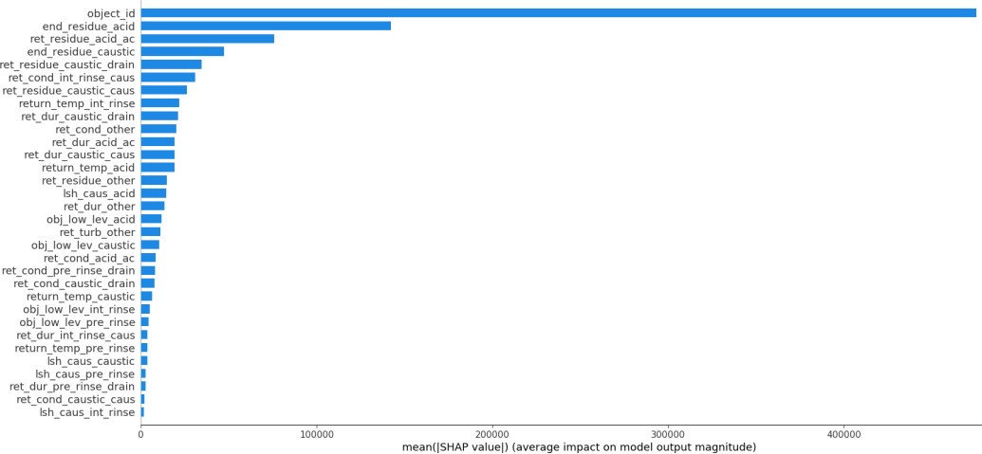
Insights
Executive Summary | Feature Engineering | Modeling | Performance | Insights | Conclusion
SHAP overview, most important predictor
Primary model interpretation technique: SHAP (Shapley Additive Explanations)
Rooted in the concept of a “Shapley value” from coalitional game theory, which attempts to distribute the “gains” or “payout” from a cooperative game to its players in a “fair” manner
Adapted to the context of black-box ML models by treating the features as players and the difference between the prediction and global average of the observed response as the payout
Shapley value of a predictor can be interpreted as the average marginal contribution to the
payout made by that predictor across all possible “predictor coalitions” which include it
Has several unique and attractive theoretical properties, such as decomposing the payouts
into contributions made by each feature in the model (efficiency), which means estimated effects of predictors are unique to each prediction
However, it is very computationally expensive; SHAP mitigates this downside by using a special weighting kernel that allows the SHAP values to be computed using weighted linear regression
Mean SHAP values for acid (full) model, training set = first 56 days of data; object_id was similarly dominant in terms of impact on predictions in other models as well
Key feature that drives model performance: object_id
Most important model feature by a very large margin across all four models
Basic EDA, such as a box-and-whisker plot, reveals stark differences in observed response
values across different objects; not an unexpected result
Baseline model with only object_id achieved a test set MAPE of 35.3%; this result is in the ballpark of the subsequent derived-feature models, again reinforcing how critical the feature is
Additional feature engineering based on implications of key feature
The overwhelming importance of object_id as a feature suggests that subsequent modeling patterns may be object-specific in nature
Consequently, several initial features were centered using object-level aggregations (median
of training set only), which led to further improvements in model performance
Original Features | Centering Method
Minimum conductivity, Minimum supply pressure | Subtract object-level median
Return flow | Divide by median
Residue (turbidity * return flow) | Turbidity * normalized return flow, which can be interpreted as a pseudo-normalized residue or a weighted turbidity

Slide 9
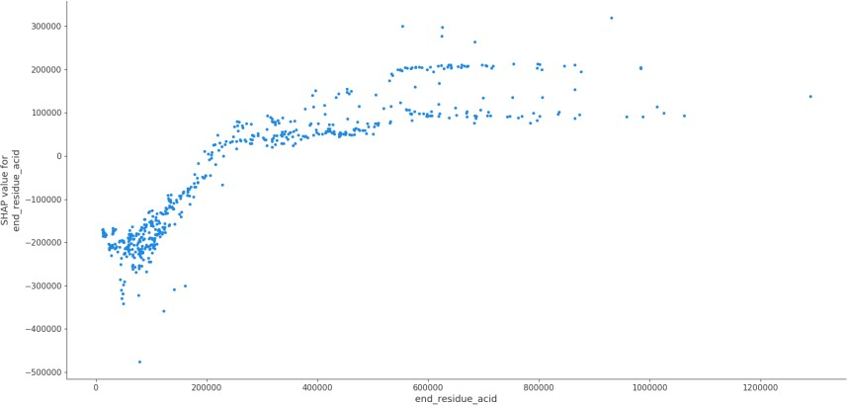
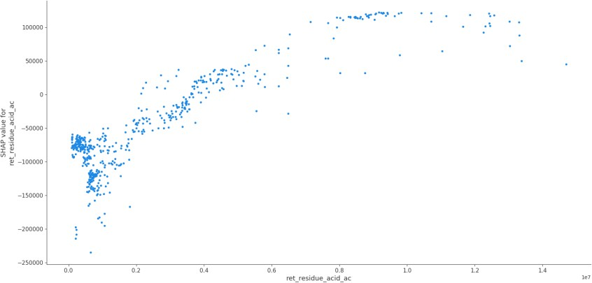
Insights
Executive Summary | Feature Engineering | Modeling | Performance | Insights | Conclusion
Residue and turbidity-derived predictors
Second-most important class of predictors: residue and weighted turbidity
These predictors account for most of the improvement in model performance over the baseline model (only object_id)
Weighted turbidity had more predictive power in first three stages; total residue produced the best results in the acid stage (full model)
Residue and turbidity were calculated in two different manners: for the entire return phase, and for just the end of the phase (last 80 seconds)
High residue/weighted turbidity is a strong indicator of high residue during the final rinse
The more total residue that flows out during (and especially at the end of) an earlier cleaning phase, the more total residue one can expect during the final rinse phase
Effect appears to be strongest for caustic and acid phases
Residue produced the best results in the acid model; weighted turbidity was similarly important in the other three models
SHAP values suggest that a total residue of 200,000 or greater during the end of the acid phase generally pushes the resulting model prediction for the response up, while a value less than 200,000 generally pushes it down (relative to the expected prediction if the predictor was omitted altogether)
A similar natural threshold can be observed for the primary acid return phase (acid phase, return acid valve open) closer to 400,000, although it is not quite as clean as the end-of-phase cutoff
SHAP dependence plots for total residue during last 80 seconds of acid phase (left) and entire acid-acid return phase (right) Each point corresponds to the SHAP value for a single validation set prediction

Slide 10
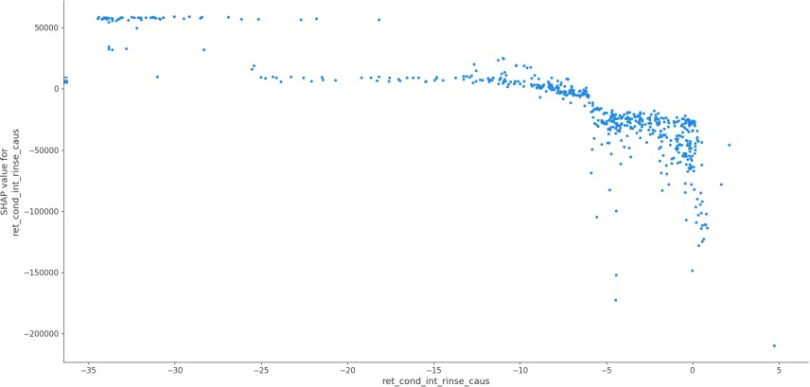
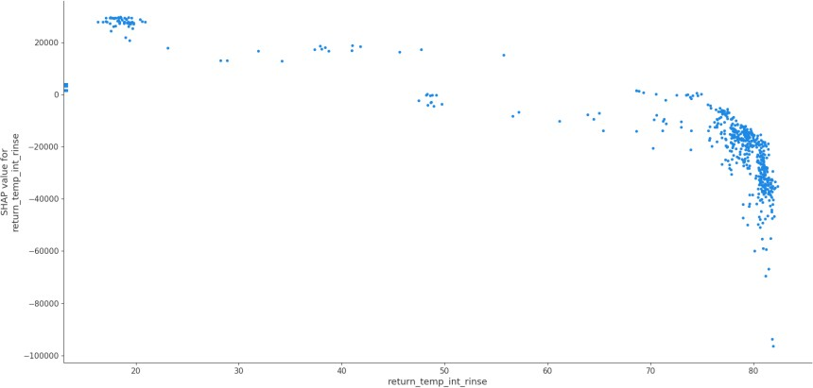
Insights
Executive Summary | Feature Engineering | Modeling | Performance | Insights | Conclusion
Other noteworthy predictors
Conductivity (minimum)
Primary predictive power comes from considering this feature when the caustic return valve is open during the intermediate rinse phase (usually at the beginning)
Centered by object_id; negative value indicates the minimum conductivity during the return phase was atypically low for that particular object
Inverse effect – the lower the minimum conductivity, the more residue we predict during the final rinse – consistent with physical intuition (one would expect a high concentration of solid particulates to reduce the conductivity of the cleaning agent)
Temperature (minimum)
Very similar in nature to conductivity – primarily useful when considered during intermediate rinse, pronounced inverse effect on final rinse residue, consistent with intuition
Unlike conductivity, not normalized prior to model building
Minimum conductivity (top) and minimum temperature (bottom) during intermediate rinse phase also resulted in non-trivial improvements in model performance
Positive/negative breakpoint is around -6 millisiemens for minimum conductivity (after centering)
Positive/negative breakpoint is around
75° C for minimum temperature
SHAP dependence plots for minimum conductivity during intermediate rinse return-phase, caustic valve open (left)
and minimum temperature during intermediate rinse phase (right)

Slide 11
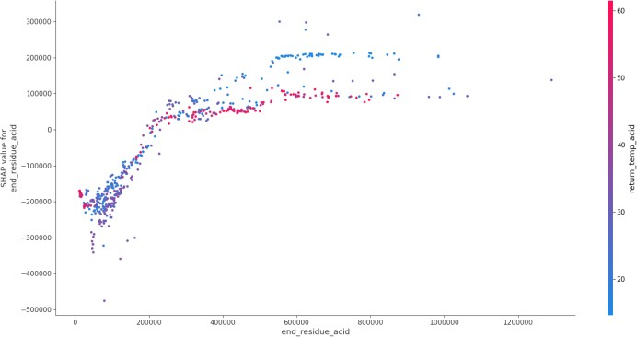
Conclusion
Executive Summary | Feature Engineering | Modeling | Performance | Insights | Conclusion
Miscellaneous insights and predictors, future work
Miscellaneous Insights
Other model predictors
Recipe type very important in pre-rinse and caustic models; 3rd largest SHAP importance value for both
Miscellaneous Predictors
In addition to the predictors that made it into the final model, several predictors which did not appear to improve predictive accuracy were thoroughly investigated:
Future Work
Operationalization
Building a real-time tool for operators to make enhanced decisions on final rinse run time using model predictions
Features derived from phase duration, obj_low_level, and tank_lsh_caustic also modestly improved predictions
Tool can leverage SHAP values to increase confidence in recommendations by illuminating the key factors driving each prediction
Measures of volatility/variability for previously discussed features (e.g. standard deviation, coefficient of variation, maximum rolling range over some fixed window, etc.)
Features derived from tank level and temperature; probably did not help due to relatively low variability
Temporal features such as day of week, hour of day, etc.
Relationships between supply and return flow (e.g. ratio of supply flow to lagged return flow)
Higher-order interactions between predictors
SHAP values can be used to identify interactions between predictors; Python implementation has built-in estimation of strongest interactions for a given predictor
Additional Data
The importance of object_id naturally suggests a number of related features that characterize each object
Brand, dimensions, primary functionality (i.e. a mixer, granulator, etc.), company that uses the equipment, what types of food are processed in the equipment, etc.
These characteristics could greatly improve how well the
predictive models generalize to newer equipment with no or little historical data
Provides deeper insight into how predictors can amplify
or dampen each others’ effects on the response
Alternative Modeling Approaches
Alternative performance metrics such as L₁ or L₂ loss could help alleviate the systematic biases that are inherent to MAPE-minimizing models
Although these features did not seem to improve model performance, they may have an impact on final rinse residue that only becomes apparent with deeper exploration (i.e. other derived features, higher-order interactions) and/or additional data
Alternative responses such as “time until rolling average turbidity drops below some threshold during final rinse phase” could lead to model-driven predictions that are more actionable for operators
Second-order dependence plot between end-of-phase total residue and min. temperature during acid phase. Striking visual patterns
that illustrate the interaction effects are readily apparent.
10

